Slide 1
Daylight Danger: Exploring the Hours When Sharks Roam Closer
What is the correlation between the time of day and the frequency of shark attacks?
By: Antonio Abreu and Samiel Zengotita

Slide 2

Shark attacks are more likely to occur during specific times of the day.
Original Dataset
Time column was inconsistent with formatting.
Country column had duplicate values.
Cleaning Techniques
Replacing strings.
Creating functions to clean time column.
Leaving out data without context.

Slide 3
Data Wrangling and Cleaning
Cleaning the Country Column
Unique Values Pre-Cleaning: 224
Challenges
After inspecting the unique values, we identified duplicates because of inconsistent formatting.
In order to create data visualization, we had to make the best effort to group the countries and reduce duplicates.
Solutions
After removing duplicates by replacing characters and white spaces, we had to filter the data by just extracting the specific time of days we are working on.
Unique Values Post-Cleaning: 194
Then we created a pivot table using the countries as index and Time of Day as columns.

Slide 4
Data Wrangling and Cleaning
Cleaning the Time Column
Unique Values Pre-Cleaning: 408
Challenges
After inspecting the unique values, we identified duplicates because of inconsistent formatting.
Data was written in a semi-military format, with h in the middle as well as some incorrectly written or with synonyms to times of the day .
Solutions
After removing duplicates by replacing characters and white spaces, we had to filter the data by just extracting the specific times of day we were working on.
Unique Values Post-Cleaning: 24
Then we created a pivot table using the countries as index and Time of Day as columns.

Slide 5
Exploratory Data Analysis
Time data was considered categorical and ordinal, since it has hierarchy.
We counted shark attacks and divided the count into times of day.
Country data was considered categorical and nominal, since there is no hierarchy.
Classifying the data helped us choose what type of visualization would be best to inform about our findings.

Slide 6
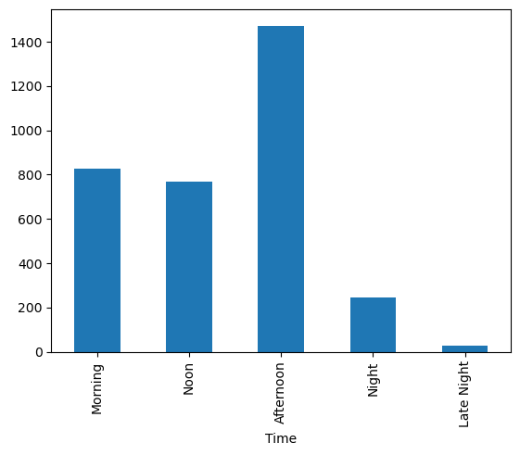
Barplot Visualization
With a barplot, we were able to compare the count of sharks attacks by time of day.
As we can see, sharks are more prone to attack during the afternoon.
Several variables may influence this conclusion, including the presence of boats or individuals in shark-prone waters at times other than the afternoon.

Slide 7
To take it a step further, we wanted to visualize the different times of day when sharks attack by country.
In the following map, we can see that sharks are more prone to attack more in specific countries, such as USA, Australia, South Africa and Brazil.

Slide 9
Obstacles
The major obstacle we faced was filtering the original dataset to create a new one with only the countries and times of day.
In the first attempt we got a series instead of a dataset, which was making it difficult to call on values to create data visualization.
We had to create a list to filter the times of day and then create a dataset that only included the values in the list.

Slide 10
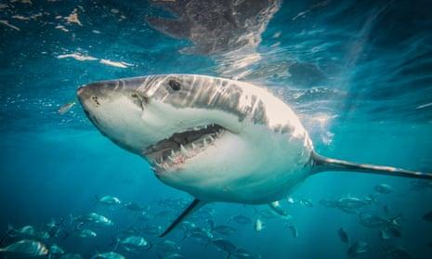
Conclusions and Insights
The original hypothesis was true.
Sharks appear to attack more in the afternoon.
Sharks appear to attack more in the USA than the rest of the world.

Slide 11
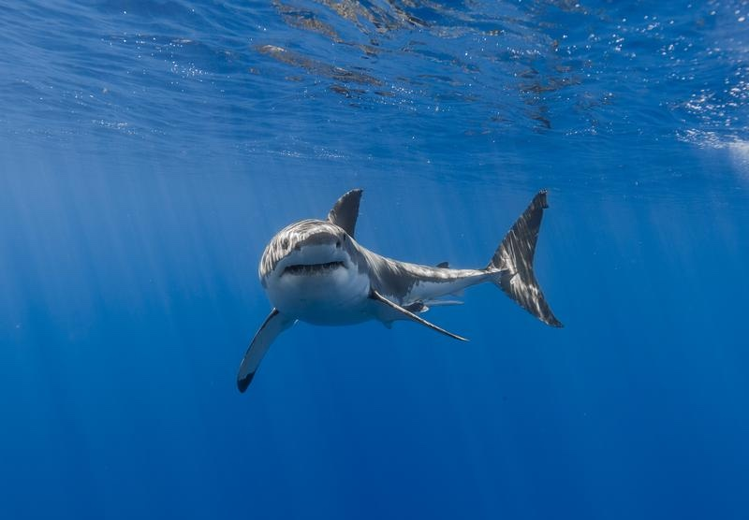
Daylight Danger:
Exploring the Hours When Sharks Roam Closer
By: Antonio Abreu and Samiel Zengotita
Thank you for your time and remember,
SHARKS DON’T SKIP LUNCH IN THE AFTERNOON.

